Slide 1
Team Project
Anh Nguyen Phung - Hung Le Ba - Peter Vo - Thu Tra

Slide 2
1, Design Choice
An RPG game that simulates Civilization with a 10x10 board.
5 different units: Archer, Catapult, Guard, Knight, Warrior. Each unit has different stats and costs, starting at Level 1.
Each player (Human or Computer) starts with 10 golds and 0 units. Each side can have a maximum of 10 units.

Slide 3
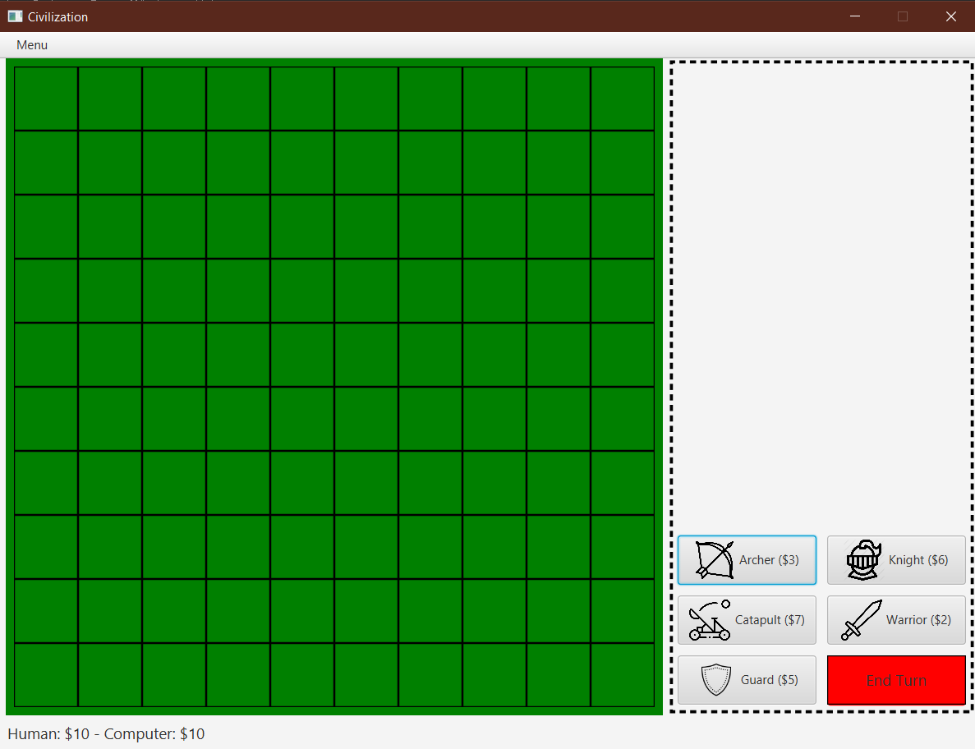
1, Design Choice

Slide 4
1, Design Choice
In each turn, a player can spawn as many units as you want if you have enough golds. A newly spawned unit can not attack/move in that turn, and the player can only spawn new units in certain areas.
In each turn, for each unit, a player can only move/attack one time.
After each turn, a player (Human or Computer) gains 2 more golds.

Slide 5
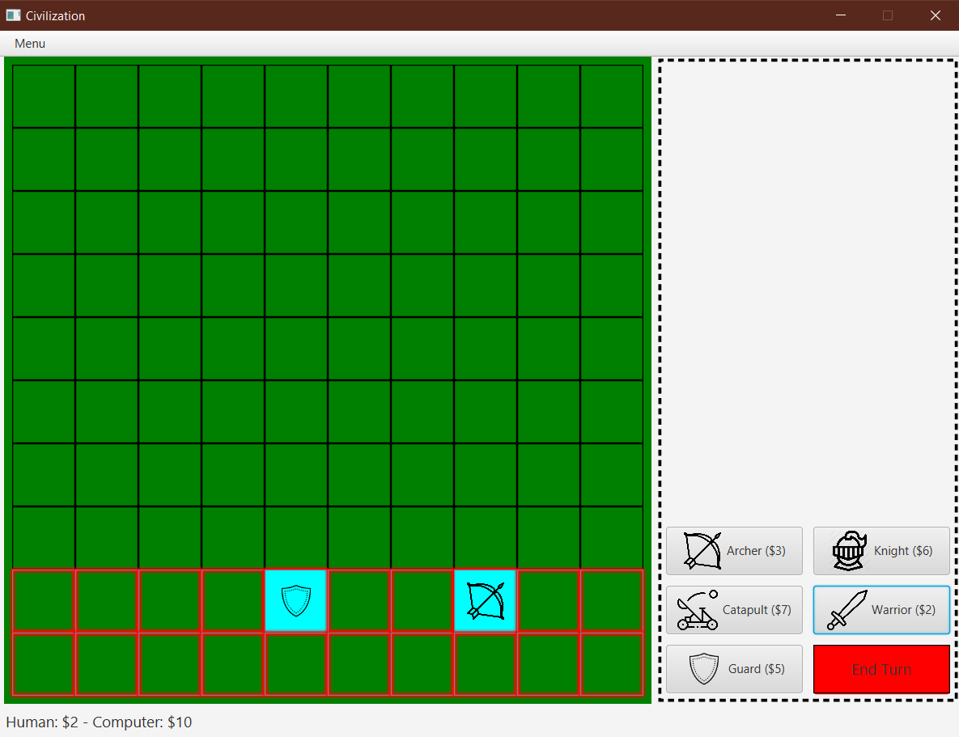
1, Design Choice

Slide 6
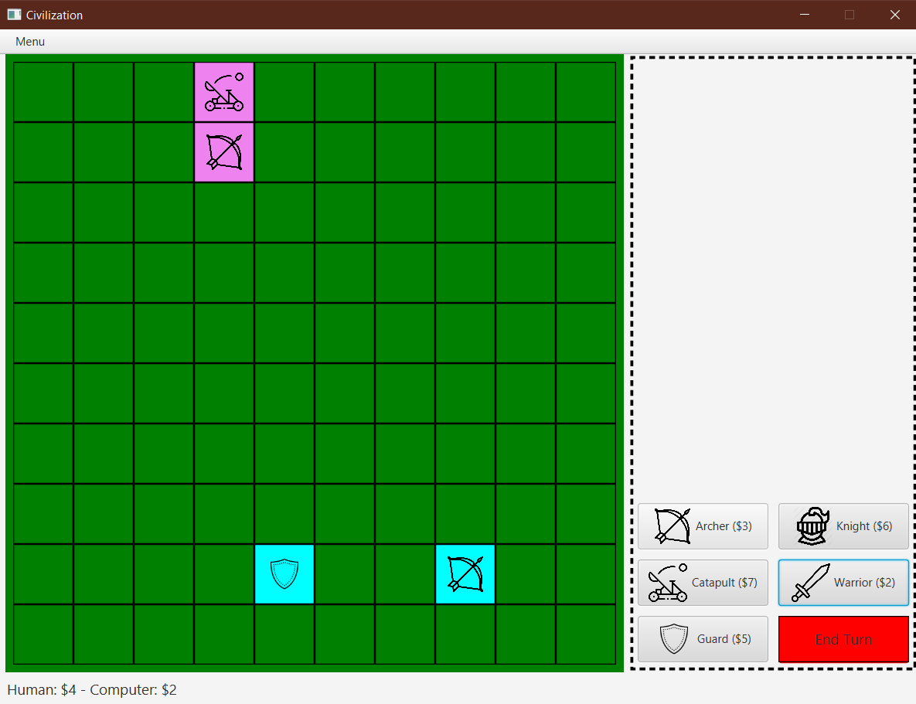
1, Design Choice

Slide 7
1, Design Choice
Every time an unit A of a player kills the opponent's unit, the player gains bonus gold based on the level of the opponent's unit (for example, if the opponent's unit is Level 3, then the player gains 3 more golds), and the unit A level up, gaining bonus health and bonus stats based the type of unit A.
The maximum level can be reached is Level 5.

Slide 8
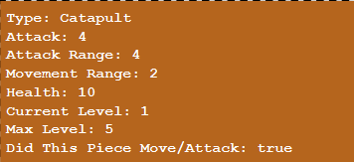
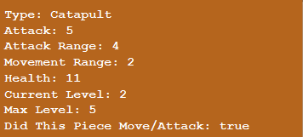
1, Design Choice

Slide 9
1, Design Choice
The game ends when one player has no units on the board, and the winner of the game is the one who still has units on the board.

Slide 10
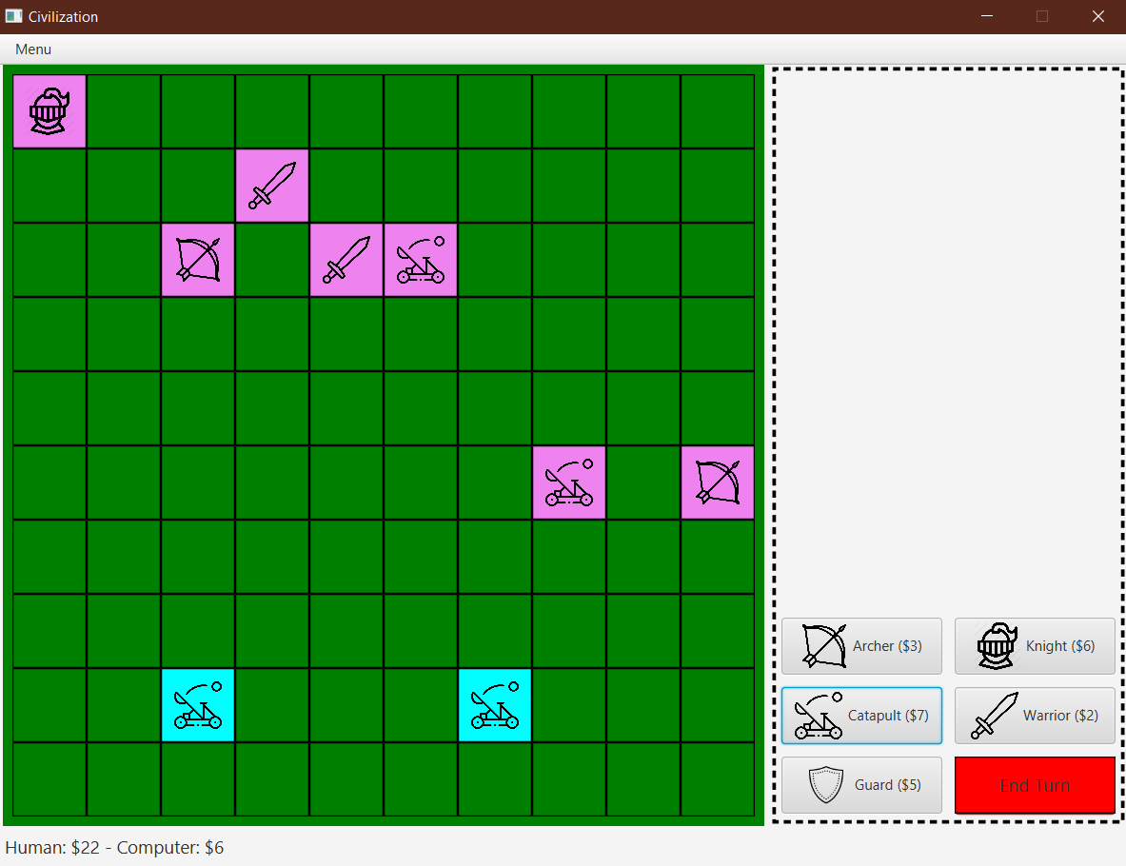
1, Design Choice

Slide 11
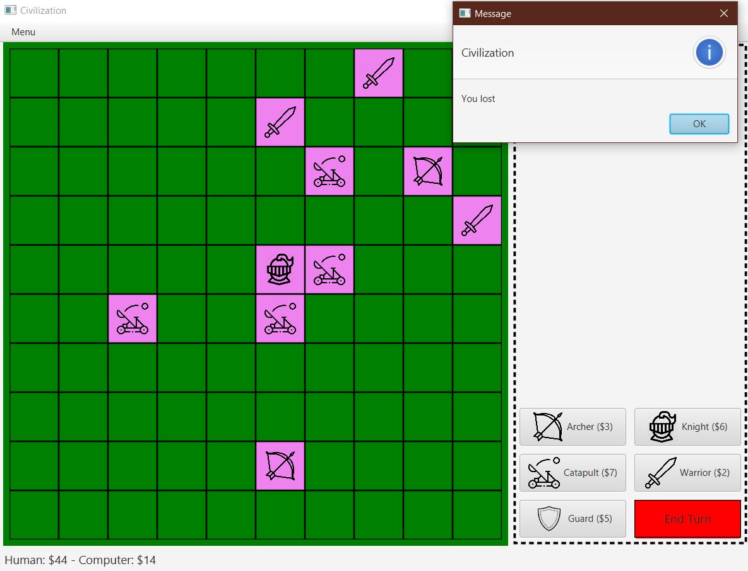
1, Design Choice

Slide 12
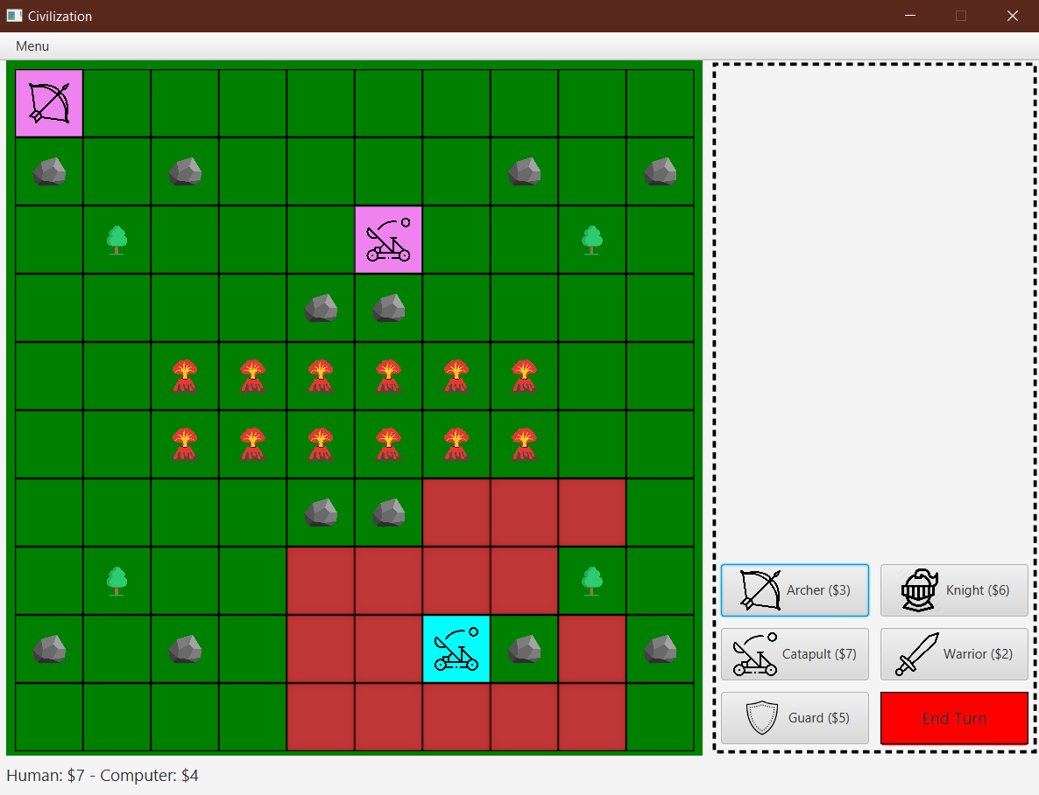
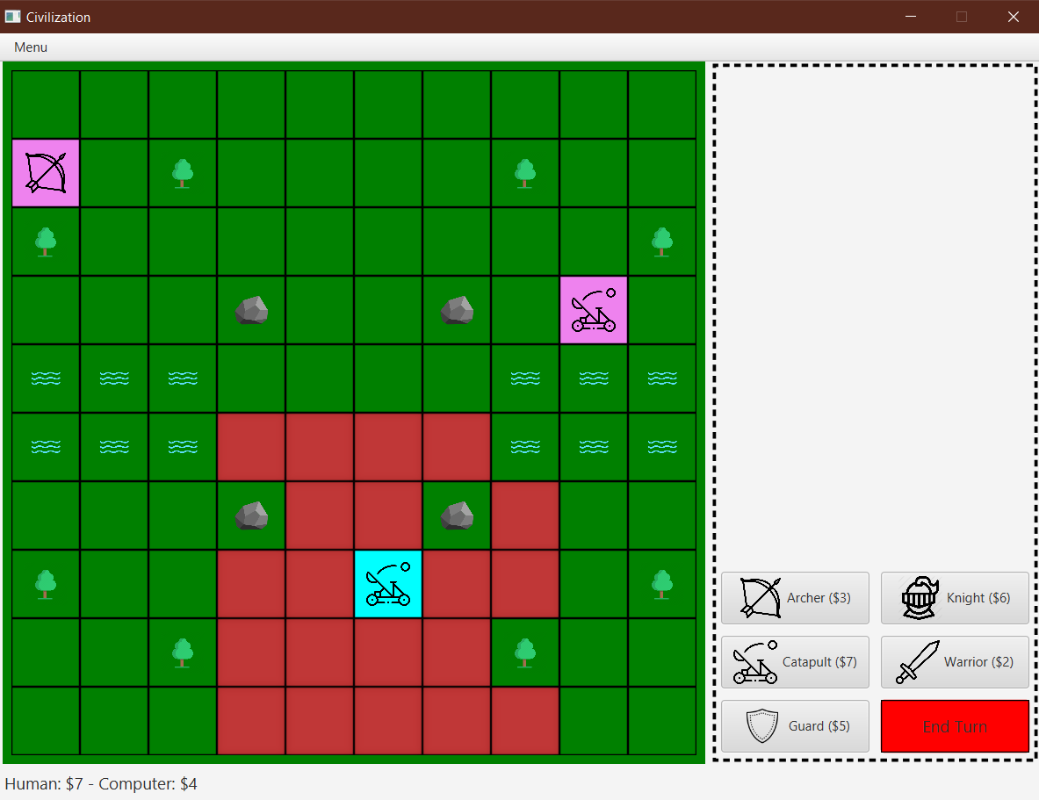
2, Wow Factor
The user can start the new game with a chosen theme

Slide 13
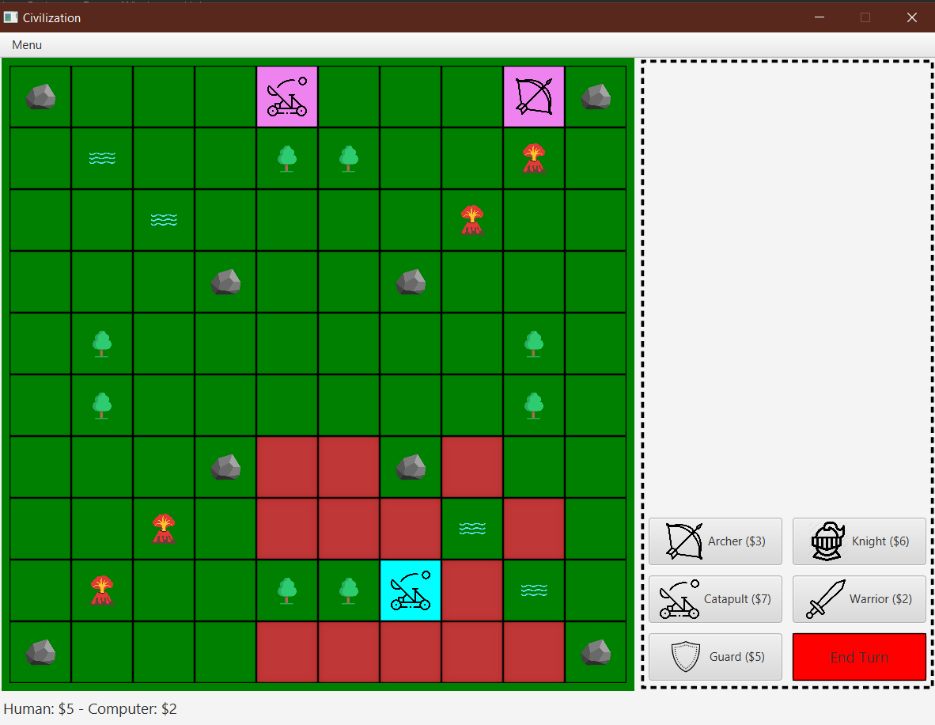
2, Wow Factor
The user can start the new game with a chosen theme

Slide 14
2, Wow Factor
When the user uses the mouse to hover over their unit in the board, the window will display all possible moves of that unit, including both movement and attack moves.

Slide 15
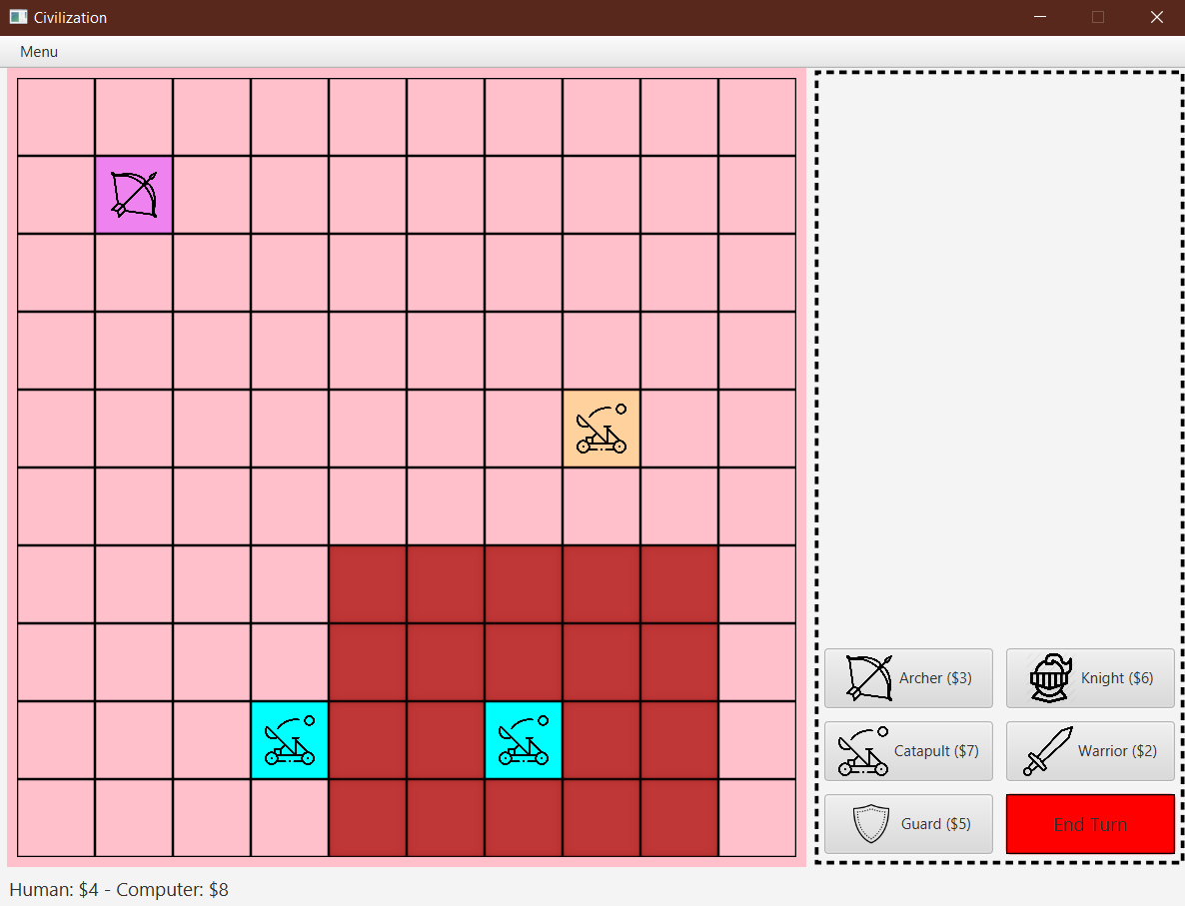
2, Wow Factor

Slide 16
2, Wow Factor
When the user right clicks a cell in the board, the window will display the information of that cell on the right of the window.

Slide 17
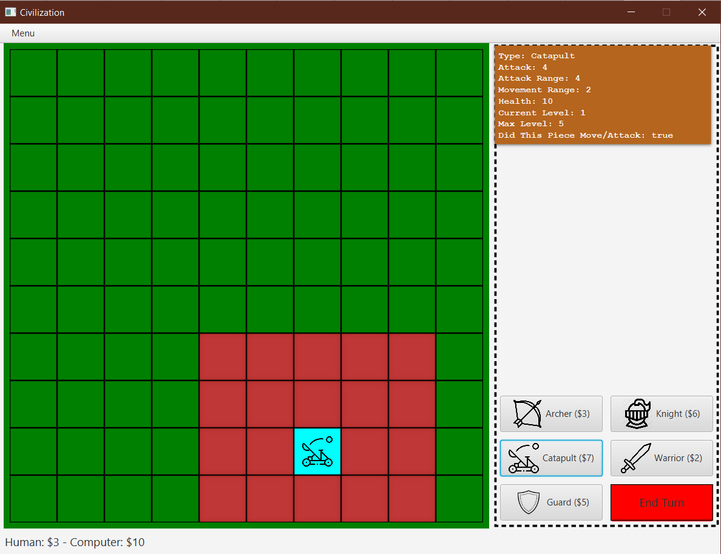
2, Wow Factor

Slide 18
2, Wow Factor
When an unit A is attacked by the opponent’s unit, that unit A’s icon disappears and appears again..

Slide 19
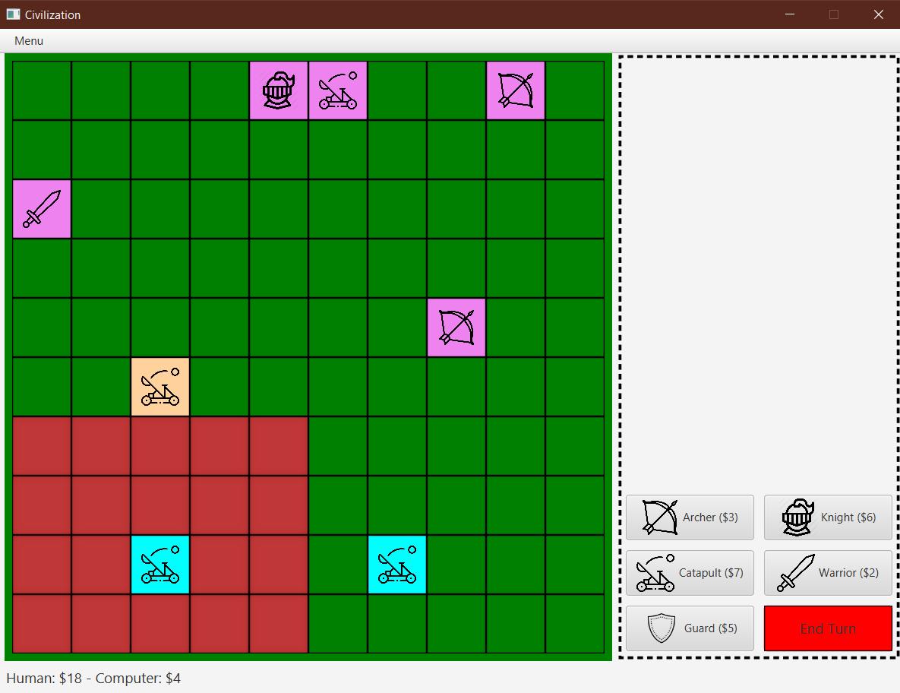
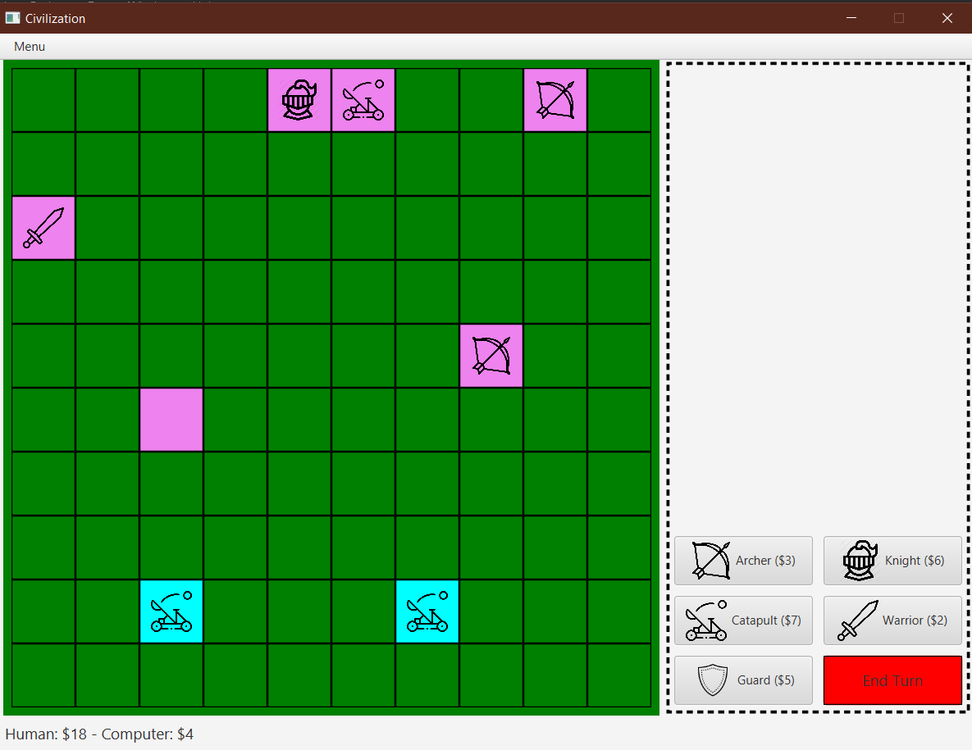
2, Wow Factor

